Slide 1
Ecosystem approach to Opioid Crisis
Anmol Bajaj
Shrikant Mudholkar
Soham Dasneogi

Slide 2
Problem Statement
The opioid and heroin epidemic touches nearly every American. Some are prescribed opioids for pain relief, some are battling opioid dependency and addiction, while others have lost a loved one to an overdose
The number of prescriptions for opioids has gone from 76 million in 1991 to nearly 207 million in 2013. In 2014, there were approximately one-and-a-half times more drug overdose deaths than deaths from motor vehicle crashes
We are creating ecosystem application that would give us insights into the root cause of the problem and help us find innovative ways to fight this evil crisis.

Slide 3

Stake holders

Slide 4
Stakeholders
1. Hospital Enterprise
Doctors can diagnose the patient and prescribe opioids if needed
Identify a pattern of opioid abuse and can recommend a patient to community rehab provider
Hospital enterprise can also see the breakdown of each opioid abuse symptom for its patients

Slide 5
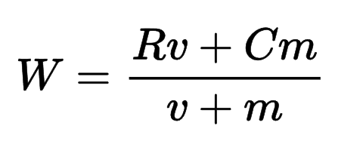
Baysian Algoritm
A Bayesian average is a method of estimating the mean of a population where instead of estimating the mean strictly from the available data set, other information – especially a pre-existing belief with regard to the population which is a central feature of Bayesian interpretation – is incorporated into the calculation which is especially relevant when the available data set is small.
Baysian Weighted rating (WR) = (v ÷ (v+m)) × R + (m ÷ (v+m)) × C
m = Total patients in the Ecosystem
v = Average of visits for all patients in the Ecosystem
c = Total symptom score for current patient
R = Average symptom score of all patients in the Ecosystem

Slide 6
Stakeholders
2. Pharmacy Enterprise
Order opioids from pharma companies
Sell opioids based on demand
Keep a track of purchase history

Slide 7
Stakeholders
3. Pharmaceutical Company Enterprise
Supply opioids
Keep a track of opioids supplied across various organizations

Slide 8
Stakeholders
4. Community Rehabilitation Enterprise
Accept patients addicted to opioids
Collaborate with hospitals to fight crisis

Slide 9
Stakeholders
5. Criminal Justice Department
Find pharmacies who are selling the opioids illegally
Find doctors who prescribe opioids despite medical history of abuse

Slide 10
Stakeholders
5. Public Health Organization (Ecosystem)
Collaborate with other organizations to find patients who are abusing opioids

Slide 11
Our Approach
An ecosystem approach could be the best hope in the battle against opioid addiction. From engaging new partners and aligning action across the ecosystem, to using a portfolio of interventions, driving innovation, and using markets to support sustainable solutions, the ecosystem is likely to generate a powerful response.
This collaborative approach inspires all stakeholders to act as a single, integrated community and point the way toward powerful new solutions.

